Slide 1

Notes:
Welcome everyone!
Today, we will explore how to design APIs that can handle anything you throw at them — whether that is a sudden traffic spike, a regional outage, or evolving business demands.
Berlin is a city of reinvention — systems adapting through decades of change, from rebuilding after war to transforming into a modern tech hub. Berlin’s infrastructure has evolved to meet new demands while keeping the city moving.
By the end of this session, you will walk away with:
A clear blueprint for building APIs that stay online under pressure.
Practical Azure patterns for scaling without overspending.
Proven monitoring and recovery strategies you can implement right away.
Like Berlin, your APIs should be built to adapt, evolve, and thrive through whatever changes occur.

Slide 2








Agenda
Building Resilient and Scalable APIs in Azure
Intro & Problem Space
Azure Toolset Overview
High Availability & Disaster Recovery
Resilience Strategies
Monitoring & Observability
Live Demo
Blueprint & Wrap Up
Q&A
Notes:
Here is our roadmap for the next xx minutes.
Like Berlin, our journey is one of adaptation and reinvention. We will start by understanding the current challenges — the “before” picture — then move into the Azure building blocks that help us evolve.
We will explore high availability and disaster recovery, similar to Berlin’s redundant transit routes and backup systems, followed by resilience strategies that adapt to changing conditions.
We will cover monitoring and observability, run a live demo, and wrap up with a blueprint for continuous improvement.
By the end, you will see how to build APIs that adapt and thrive through decades of change.

Slide 3
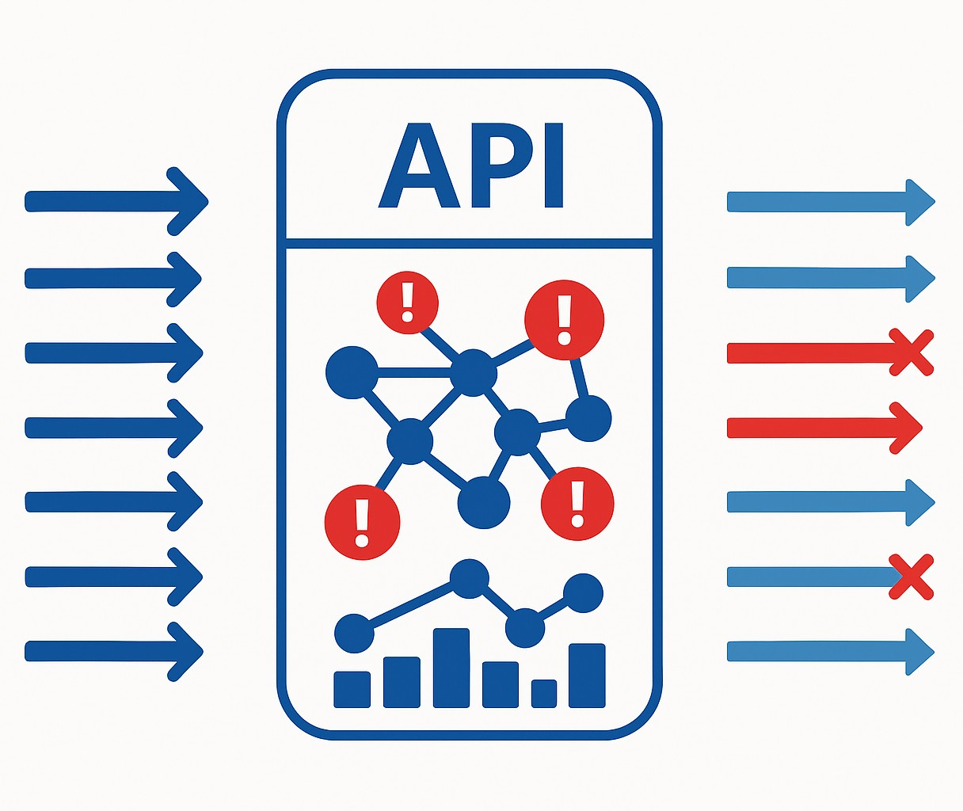

The Resilience Challenge
Building Resilient and Scalable APIs in Azure
Notes:
Berlin’s transit system is a marvel of planning — but even it faces strikes, sudden closures, and unexpected surges. When a key U-Bahn line shuts down, the city has to reroute thousands of passengers instantly.
Your APIs face the same reality. A dependency fails, and suddenly, you are rerouting requests, throttling traffic, or gracefully degrading to keep the core experience alive.
And just like Berlin’s history of reinvention — rebuilding, modernizing, adapting — our systems must evolve to meet new demands. The threats are constant: traffic spikes, cascading failures, risky deployments. The question is whether we have built in the flexibility to respond without breaking.
That is what resilience is about — not avoiding change but absorbing it and coming out stronger.

Slide 4










Resilience Turnaround
From Fragile to Fault-Tolerant: An API Resilience Transformation
Before (Challenges)
After (Results from Azure Patterns & Services)
Legacy Stack
Unplanned Outages
Cascading Failures
Protected Gateway
Multi-Region
Smart Patterns
No visibility
Manual Recovery
Live Metrics
Scales on Demand
Notes:
Let me give you a realistic example.
There is an organization that started with a patchwork of legacy integration systems and a couple of home-grown API gateways. They were fine on a normal day, but when traffic spiked, the cracks showed. Requests piled up, upstream services failed, and without throttling or caching, these failures cascaded.
They had no real-time visibility, so they were always reacting after customers felt the pain. Every failover was manual, expensive in both time and money.
They decided to re-architect with resilience in mind, using the exact patterns and Azure services we will be talking about today. Azure API Management became their consistent front door, enforcing policies, caching responses, and shielding backends. They deployed across multiple regions with Azure Front Door, so it one region had trouble, traffic flowed seamlessly to another. They built retry and circuit breaker logic into both APIM and their service code. They also wired up Azure Monitor and Application Insights to spot trouble before users did.
The result? A platform that now takes traffic surges in stride, shrugs off upstream hiccups, and has cut downtime dramatically — all while delivering a 315% ROI. This is the kind of transformation we are aiming for in this session.

Slide 5
Azure Toolset Overview
Notes:
We have just experienced the reality of API resilience challenges — the surges, dependency failures, cascading slowdowns, and deployment risks.
Berlin understands adaptation. Over the decades, this city has been rebuilt, re-planned, and re-engineered — not just to recover from disruption, but to emerge stronger each time. Its systems are designed to handle change, whether a sudden influx of people, a transit strike, or a significant infrastructure upgrade.
Resilient APIs follow the same philosophy. They are not the product of chance — they are the result of deliberate design choices that give you:
Control at the edge — like a central station directing trains and buses to keep the network flowing.
Elasticity in the middle — like adding extra S-Bahn carriages when the platforms are crowded.
Intelligence throughout — like transit monitoring that reroutes passengers before delays cascade.
You can build those capabilities on many platforms — Kubernetes in AKS, App Service Web Apps, even traditional VMs — and the principles will apply to all of them.
For this session, though, we will focus on serverless technologies where possible. Why? Because serverless gives us some of those resilience superpowers right out of the box:
It scales automatically with demand — like opening extra tram lines during a festival.
It removes much of the operational overhead, so we can focus on API logic and resilience patterns — instead of maintaining the “tracks and switches.”
And it aligns cost with usage, so you are not paying for empty trains at midnight.
Think of it as starting with a city that already has flexible infrastructure and on-demand capacity built in. We will still add safety systems, backup routes, and monitoring, but the base is already designed to handle stress.
In this next section, we will examine the specific Azure building blocks that give us those capabilities and how they work together to create APIs that survive under pressure, evolve, and thrive, just like Berlin.

Slide 6

Azure Toolset Overview
Primary Trio
Azure API Management
Traffic Shaping and Throttling
Caching
Policy Enforcement
Backend Shielding
Notes:
Let’s start at the front door of our API platform, Azure API Management, or APIM.
In Berlin terms, APIM is like the Hauptbahnhof — the city’s central station — combined with the transit control center. Every train, tram, and bus route passes through a coordinated system that decides where it goes, how fast it moves, and how it connects to the rest of the network.
From a resilience perspective, APIM gives us several critical capabilities:
Traffic shaping and throttling: Like regulating train departures so platforms do not become dangerously overcrowded.
Caching: Serving repeat requests instantly, like a well-timed S-Bahn connection keeping passengers moving without re-processing every ticket.
Policy enforcement: Applying consistent rules for authentication, transformation, and validation, just as Berlin’s transit system applies uniform standards across all lines.
Backend shielding: Insulating fragile or high-latency services from the chaos of peak-hour demand.
This is where we can implement circuit breakers, retries, and failover routing at the edge — stopping problems before they cascade deeper into the system.
And because APIM is a single, consistent entry point for all APIs, we can roll out resilience patterns once and have them apply everywhere — just like a central control center can adjust schedules and routes across the entire city network in real time.
In short, APIM is our first line of defense and our first opportunity to optimize. It is where we absorb the initial shock of a traffic surge, gracefully handle upstream issues, and keep the rest of the platform stable — just as Berlin’s transit system keeps the city moving, even when the pressure is on.

Slide 7

Azure Toolset Overview
Primary Trio
Azure API Management
Azure Functions
Elastic Capacity
Scale-to-Zero Efficiency
Event-Driven Triggers
Isolation of Workloads
Notes:
After APIM has managed the flow at the front door, we need a way to handle the work itself when demand changes instantly.
In Berlin terms, Azure Functions is like the extra S-Bahn carriages or pop-up tram lines that appear during a festival — or the temporary crews that set up and dismantle infrastructure as needed.
From a resilience perspective, Functions gives us:
Elastic Capacity — like adding more carriages to clear a busy platform.
Scale-to-zero efficiency — no empty trams running when the streets are quiet.
Event-driven triggers — responding to real-time signals from the network.
Isolation of workloads — each “crew” or “line” operates independently, so one disruption doesn’t halt the whole system.
It’s our on-demand workforce — appearing exactly when needed, then stepping back when the job is done.

Slide 8

Azure Toolset Overview
Primary Trio
Azure API Management
Azure Functions
Azure Container Apps
Granular Scaling
Multiple Scale Triggers
Revisions and Blue-Green Deployments
Service-to-Service Communication
Notes:
Once APIM has directed traffic and Functions has handled the quick, event-driven jobs, we need a way to run core services that operate continuously but can adapt to changing demand.
In Berlin terms, Azure Container Apps is like the S-Bahn and U-Bahn lines that run all day but can add extra carriages during rush hour or adjust routes during construction.
From a resilience perspective, Container Apps gives us:
Granular scaling — like adding or removing trains based on passenger load.
Multiple scale triggers — responding to real-time passenger counts, not just a fixed schedule.
Revisions and blue-green deployments — like trialing a new timetable on one line before applying it across the network.
Service-to-service communication — secure, internal “track changes” between lines without sending passengers outside the system.
It is our flexible backbone — always running, but able to adapt instantly when the city’s needs change.

Slide 9







Who is Chad Green?
chadgreen@chadgreen.com
TaleLearnCode
ChadGreen.com
ChadGreen & TaleLearnCode
ChadwickEGreen

